Slide 1
Linear Regression
Y.LAKSHMI PRASAD
08978784848

Slide 2
Objectives
1. State the Modeling Steps
2. Describe the Linear Regression Model
3. Explain Ordinary Least Squares
4. Compute Regression Coefficients
5. Residual sum of squares (RSS) and R² (R-squared)

Slide 3
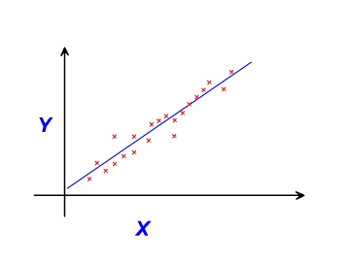
Simple Linear Regression
Simple linear regression explains the relationship between a dependent variable and one independent variable using a straight line.
The straight line is plotted on the scatter plot of these two points.

Slide 4
Simple Linear regression
In Simple Linear regression, one variable is considered independent (=predictor) variable (X) and the other the dependent (=outcome) variable Y (Continuous in nature).

Slide 5
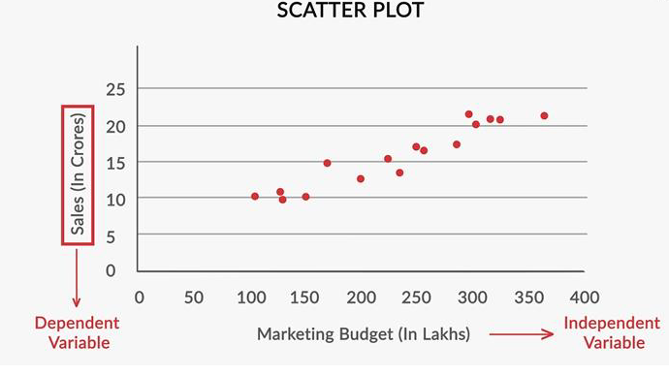
Scatter Plot

Slide 6
Regression Analysis
To determine whether the independent variables explain a significant variation in the dependent variable: whether a relationship exists.
To determine how much of the variation in the dependent variable can be explained by the independent variables: strength of the relationship.
To determine the structure or form of the relationship: the mathematical equation relating the independent and dependent variables.

Slide 7
Linear Regression can be used to answer the following questions:
Can variation in sales be explained in terms of variation in advertising expenditures? What is the structure and form of this relationship, and can it be modeled mathematically by an equation describing a straight line?
Can the variation in market share be accounted for by the size of the sales force?
Are consumers’ perceptions of quality determined by their perceptions of price?

Slide 8
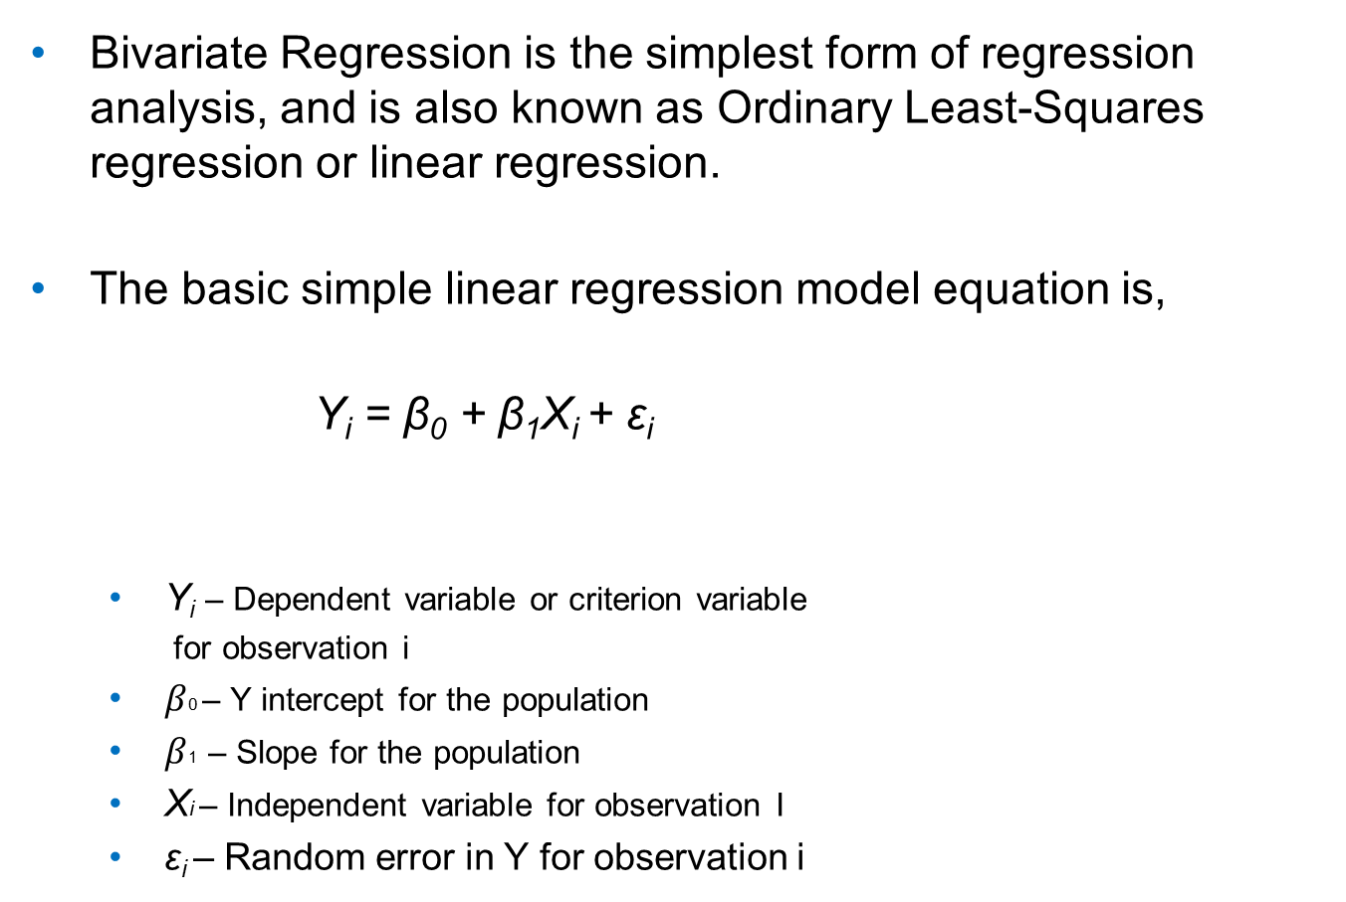
Bivariate Regression
Bivariate Regression is the simplest form of regression analysis, and is also known as Ordinary Least-Squares regression or linear regression.
The basic simple linear regression model equation is,
Y_{i}= β₀ + β₁X_{i} + ε_{i}
Y_{i}– Dependent variable or criterion variable
for observation i
$β$0 – Y intercept for the population
$β$1– Slope for the population
Xi– Independent variable for observation I
ε_{i}– Random error in Y for observation i

Slide 9
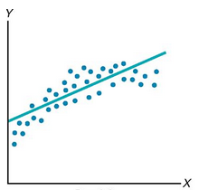
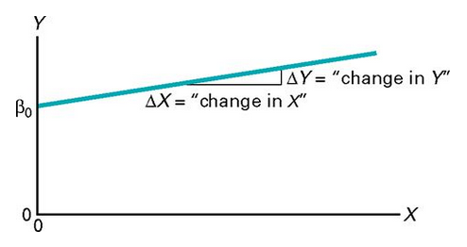
Regression Line

Slide 10
Intercept and Slope
Since X been given, and we need to predict something about Y, we require the other 2 parameters, those are slope and intercept.
Intercept is the value of Y, when X becomes Zero.
A slope of 2 means that every 1-unit change in X yields a 2-unit change in Y.

Slide 11
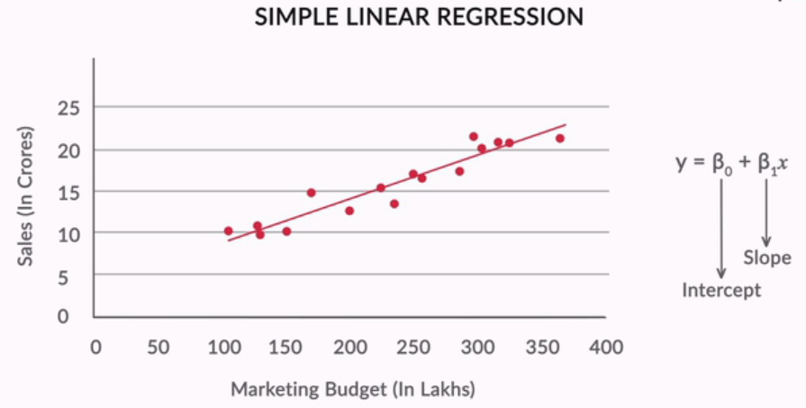
Simple Linear Regression

Slide 12
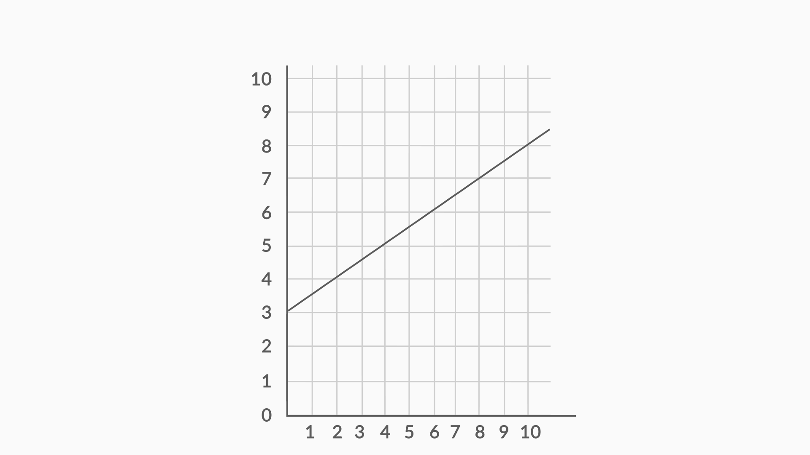
Regression Line

Slide 13
Intercept of a Straight Line
What is the intercept of the given line?
Use the graph given above to answer this question.
A) 0
B) 3
C) 4
D)1/2

Slide 14
Feedback :
Feedback :The value of y when x = 0 in the given straight line is 3.
So, 3 would be the intercept in this case.

Slide 15
Slope of a Straight Line
What is the slope of the given line?
Use the graph given above to answer this question.
A) 1/2
B) 1/3
C) 1
D) 2

Slide 16
Feedback
Feedback :The slope of any straight line can be calculated by (y₂ - y₁)/(x₂ - x₁), where (x₁, y₁) and (x₂, y₂) are any two points through which the given line passes. This line passes (0,3) and (2, 4); so the slope of this line would be (4-3/2-0) = ½.

Slide 17
Equation of a Straight Line
What would be the equation of the given line?
A) Y = X/2 + 3
B) Y = 2X + 3
C) Y = X/3 + ½
D) Y = 3X + ½

Slide 18
Feedback :
The standard equation of a straight line is y = mx + c, where m is the slope and c is the intercept.
In this case, m = ½ and c = 3, so equation would be Y = X/2 + 3.

Slide 19
strength of the linear regression
The strength of the linear regression model can be assessed using 2 metrics:
1. R² or Coefficient of Determination
2. Adjusted R²

Slide 20


Least-Squares Method
Minimizes the sum of squared differences between the actual values (Y_{i} ) and the predicted values ( )
Using the = b₀ + b₁X_{i} , the sum of squared differences is equal to

Slide 21
Least-Squares Method
This method determines the values of b₀ & b₁ that minimize the sum of squared differences around the prediction line.
Any values for b₀ & b₁ other than those determined by the least-squares method result in a greater sum of squared differences between the actual values (Y_{i} ) and the predicted values ( )

Slide 22
Best Fit Line
The best-fit line is found by minimising the expression of RSS (Residual Sum of Squares) which is equal to the sum of squares of the residual for each data point.
Residuals for any data point is found by subtracting predicted value of dependent variable from actual value of dependent variable.

Slide 23
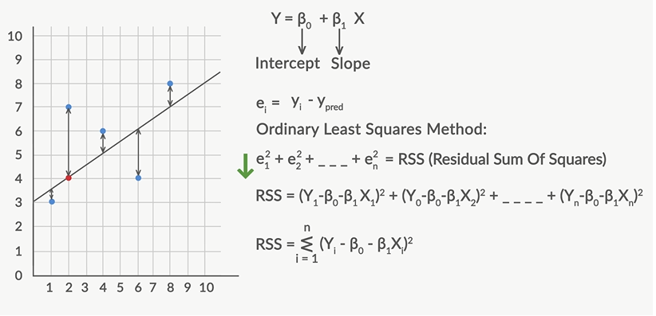
Residuals

Slide 24
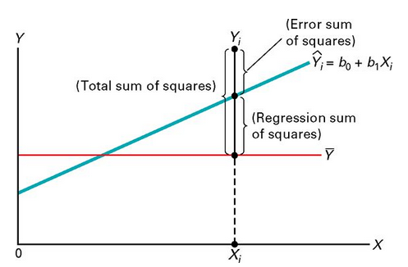
Measures of Variation
When using Least square methods to determine regression coefficients, 3 measures of variation needs to be computed.
SST = SSR + SSE
SST – Total sum of squares
SSR – Regression sum of squares (Explained variation)
SSE – Error sum of squares (Unexplained variation)

Slide 25
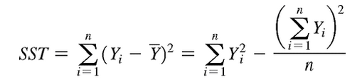
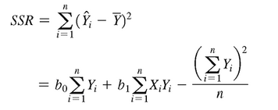
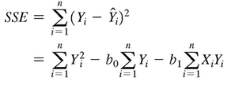
Measures of Variation
Total sum of squares
Regression sum of squares
Error sum of squares

Slide 26
Best Fit Regression Line
What is the main criterion used to determine the best-fitting regression line?
A) The line that goes through the most number of points
B) The line that has an equal number of points above it or below it
C) The line that minimises the sum of squares of distances of points from the regression line
D) None

Slide 27
Feedback :
Answer C: The criterion is given by the Ordinary Least Squares (OLS) method, which states that the sum of squares of residuals should be minimum.

Slide 28
Correlation Coefficient (r)
Correlation Coefficient is the statistic summarizing the strength of association between two variables.
It is an index used to determine whether a linear or a straight line relationship exists between X and Y.
It was originally proposed by Karl Pearson, hence (r) is also known as Pearson Correlation Coefficient.

Slide 29
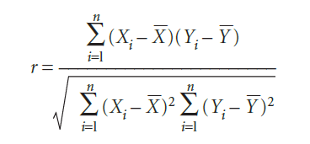
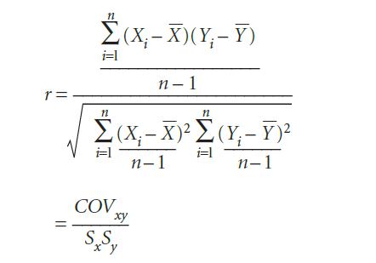
Correlation Coefficient (r)
Division of the numerator and denominator by n – 1 gives
- X_{bar} and Y_{bar} denote sample means
- s_{x} and s_{y} are the standard deviations
- COV_{xy} is the covariance between X and Y

Slide 30
Correlation Coefficient (r)
Covariance is a systematic relationship between two variables in which change in one implies a corresponding change in the other (COV_{xy}).
The covariance between X and Y, measures the extent to which X and Y are related.
The covariance may be either positive or negative

Slide 31
Correlation Coefficient (r)
Division of COV_{xy} by s_{x}s_{y} achieves standardization, so r varies between -1.0 and 1.0
It is absolute number and is not expressed in any unit of measurement.
The correlation coefficient will be the same regardless of their underlying units of measurement.
r can also be expressed in terms of the decomposition of total variation. (i.e. r²)

Slide 32
Coefficient of Determination (r2)
r² = Explained variation / Total variation
r² = SSR / SST
The ratio of the regression sum of squares (SSR) to the total sum of squares (SST) measures the proportion of variation in Y that is explained by the linear relationship of the independent variable X with the dependent variable Y in the regression model
r² must be a value between 0 and 1. It cannot be negative.
Larger r² indicates a strong linear relationship between two variables.

Slide 33
Coefficient of Determination (r2)
r² = Explained variation / Total variation
r² = SSR / SST
The ratio of the regression sum of squares (SSR) to the total sum of squares (SST) measures the proportion of variation in Y that is explained by the linear relationship of the independent variable X with the dependent variable Y in the regression model
r² must be a value between 0 and 1. It cannot be negative.
Larger r² indicates a strong linear relationship between two variables.

Slide 34

Standard Error of the Estimate
It measures the variability of the observed Y values to the predicted Y values.
Although the least-square method produces the line that fits the data with the minimum amount of prediction error, unless all the observed data points fall on a straight line, the prediction line is not a perfect predictor.
The figure shows the variability
around the prediction line.
Note: Many observed values of Y fall
near the prediction line, but most of
the values are exactly not on the line.

Slide 35
Standard Error of the Estimate
The interpretation of the standard error of the estimate is similar to that of the standard deviation.
The standard deviation measures variability around the mean.
The standard error of the estimate measures variability around the prediction line.

Slide 36
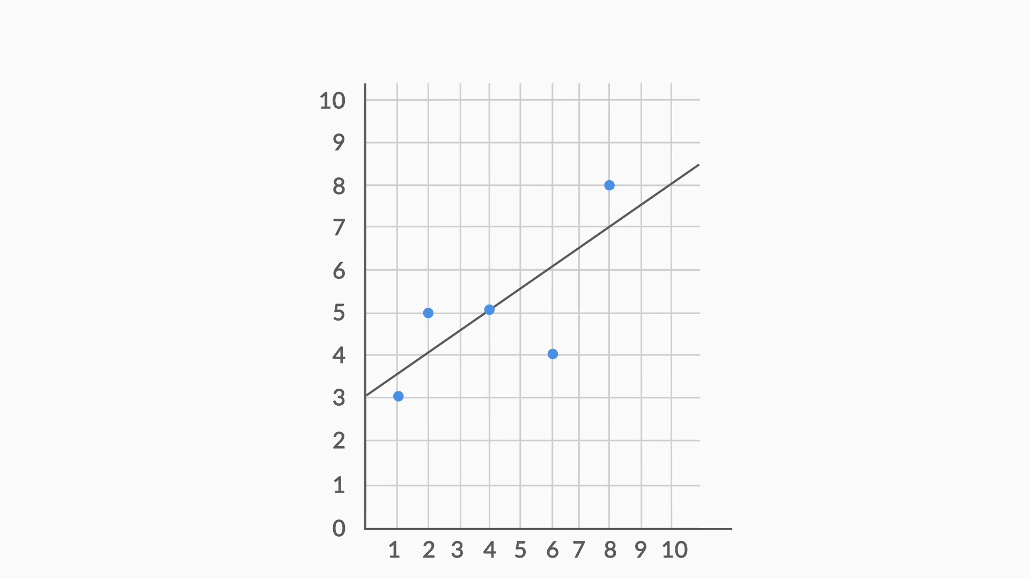
RSS Plot

Slide 37
Residual Sum of Squares (RSS)
Find the value of RSS for this regression line.
A) 0.25
B) 6.25
C) 6.5
D) -0.5

Slide 38
Feedback :
The residuals for all 5 points are -0.5, 1, 0, -2, 1.
The sum of squares of all 5 residuals would be 0.25 + 1 + 0 + 4 + 1 = 6.25

Slide 39
Total Sum of Errors (TSS)
Find the value of TSS for this regression line.
A) 11.5
B) 7.5
C) 0
D) 14

Slide 40
Feedback :
The average of y-value for all data points (3 + 5 + 5 + 4 + 8)/5 = 25/5 = 5.
So y−¯y term for each data point would be -2, 0, 0, -1, 3.
So, the squared sum of these terms would be 4 + 0 + 0 + 1 + 9 = 14.

Slide 41
R²
The RSS for this example comes out to be 6.25 and the TSS comes out to be 14.
What would be the R² for this regression line?
A) 1 - (14/6.25)
B) (1 - 14)/6.25
C) 1 - (6.25/14)
D) (1 - 6.25)/14

Slide 42
Feedback
R² value is given by 1 - (RSS / TSS). So, in this case, R² value would be 1 - (6.25 / 14).

Slide 43
Adj. R-Squared
adjusted R-squared is a better metric than R-squared to assess how good the model fits the data.
Adjusted R-squared, penalises R-squared for unnecessary addition of variables.
So, if the variable added does not increase the accuracy adequately, adjusted R-squared decreases although R-squared might increase.

Slide 44
4 Questions we need to ask ourselves:
Whenever you are about to build a Model, Ask yourself these 4 Questions:
1. What is the Objective Function?
2. What are the Hyper-parameters?
3. What are the Parameters?
4. How can we Regularize this Model?

Slide 45
Linear Regression Model
1. What is the Objective Function?
→ Find out that line which minimizes the MSE
2. What are the Hyper-parameters?
→ alpha=, fit_intercept=, max_iter=, tol=, solver=, random_state=
3. What are the Parameters?
→ Intercept(B0) and Slope Coefficient (B1)
4. How can we Regularize this Model?
→ L1 Norm(LASSO), L2 Norm(Ridge Regression)

Slide 46
Multiple linear regression
Multiple linear regression is a statistical technique to understand the relationship between one dependent variable and several independent variables (explanatory variables).
The objective of multiple regression is to find a linear equation that can best determine the value of dependent variable Y for different values independent variables in X.

Slide 47
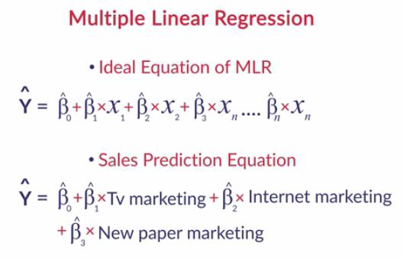
Multiple linear regression

Slide 48
Questions?

